Slide 1
Proposal Template

Slide 2
Solution Scoping
Overall brief description of your chosen business scenario
Describe the user scenarios that are to be implemented in your solution
A user scenario starts from a user action through certain UI
A user scenario can be described as a business process.
In a business process, it can trigger one or more (micro)services, which may be built by you or come from external service providers

Slide 3
Solution Design
Draw the microservice interaction diagrams for each user scenario
Draw a technical overview diagram to show the intended (micro)services that may be built by yourself or from Google, Facebook, PayPal, etc.
The more detailed proposal, the better. This is to facilitate your discussion with instructors and later implementations. E.g.,
Communication patterns and technologies; URL paths, routing/binding keys;
Database table schemas; JSON data models for communication;
The diagrams for the proposal can be
On paper or electronic;
Draft, rough, unpolished, omitting low-level implementation details

Slide 4
Sample Overall Business Scenario
Airline Enterprise Solution
User scenarios
Passenger pays for flight via online portal
Airline returns with confirmation of flight
System enables check-in x hours before flight
System allocate seats upon check-in
Notes:
Taxi Booking Enterprise Solution will be implemented using microservices architecture comprising a number of microservices and some external services.
There can be two user interactions here:
Start to book a ride Provides the pickup location & destination in order to get the price of this booking request.
Book for a ride After seeing the price, if the passenger wants to go ahead, use the UI to click on a Book button to send the request

Slide 5
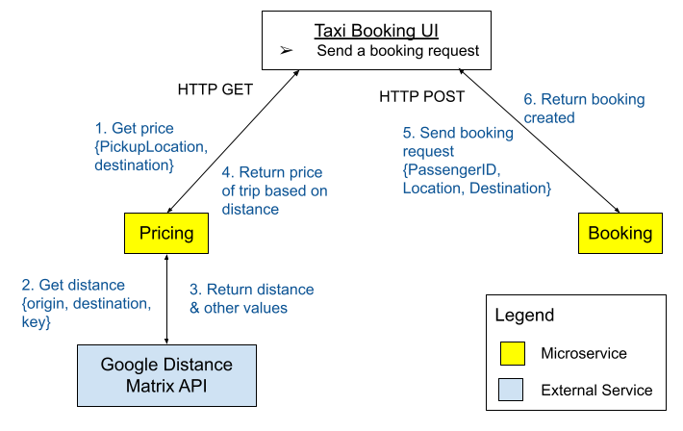
Microservice Interaction Diagram – Passenger sends a booking request
Notes:
You may put more details about the communications (e.g., the URL for the (micro)services, the input parameters for the (micro)services along with the URLs), data stores used for the (micro)services, etc.) in the diagrams, as long as they are clean and easily readable.
This is a good place to consider what microservices should be built and what external services can be used to support the user scenario.
The process:
Passenger sends a booking request for a taxi through the UI by keying in destination of journey
UI invoke Pricing service, Get price operation to obtain the price for this journey
Pricing service calls the Google Distance Matrix API to obtain the distance for price calculation
Returns distance and other values to the Pricing service
Returns the price of trip based on the distance calculated
UI displays the price of trip and user clicks on Book, to initiate the booking request
UI invokes Booking service, New Booking operation to create a new booking with the status = open
Returns new booking created. At this point, booking is not confirmed as it is pending assignment of a driver, to complete this booking.
You may use double-headed arrows lines to represent request-reply communications.

Slide 6
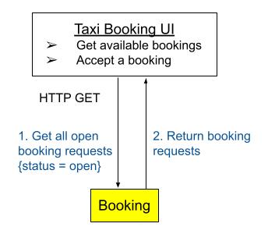
Microservice Interaction Diagram – Driver accepts a booking request - Step 1
Notes:
You may put more details about the communications (e.g., the URLs, the AMQP binding/routing keys for the (micro)services, the input parameters, correlation ids, data stores, etc.) in the diagrams, as long as they are clean and easily readable.
Taxi driver uses UI to find a booking. The driver uses the UI to invoke the Booking service, via [GET] /booking/open to get all open bookings.
Return all bookings that are currently with the status = open. UI displays all bookings and driver selects a specific one
Triggers UI to invoke Accept Booking complex microservice, [POST] /acceptbooking/{bookingID}, to orchestrate the accept booking process.
The Accept Booking microservice invokes Booking microservice, [PUT] /booking/{bookingID}, to update the status of the booking
The Accept Booking microservice invokes Passenger microservice, [GET] /passenger/{passengerID}, to obtain Passenger information.
Passenger microservice returns the passenger information (e.g. contact details).
Accept Booking microservice sends a message {passengerID, driverID, phone} with routing key passenger.notify to a topic message exchange. SMS service will receive the message based on binding key *.notify and send a SMS to the passenger.
The Accept Booking service upon receiving passenger information returns the confirmation of the booking to the Taxi Driver UI.
You may use either double-headed arrows or 2 uni-direction arrows to depict request-reply.

Slide 7
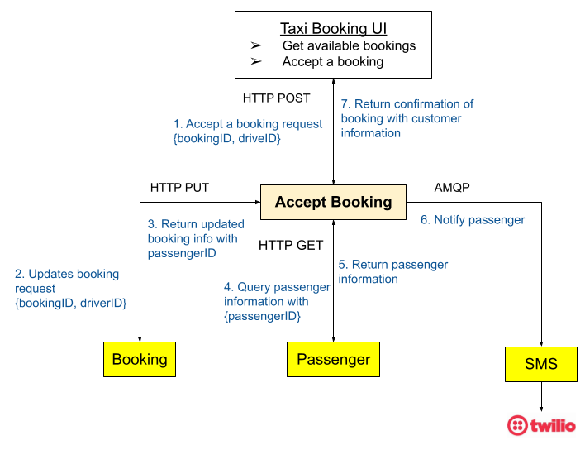
Microservice Interaction Diagram – Driver accepts a booking request - Step 2
Notes:
You may put more details about the communications (e.g., the URLs, the AMQP binding/routing keys for the (micro)services, the input parameters, correlation ids, data stores, etc.) in the diagrams, as long as they are clean and easily readable.
Taxi driver uses UI to find a booking. The driver uses the UI to invoke the Booking service, via [GET] /booking/open to get all open bookings.
Return all bookings that are currently with the status = open. UI displays all bookings and driver selects a specific one
Triggers UI to invoke Accept Booking complex microservice, [POST] /acceptbooking/{bookingID}, to orchestrate the accept booking process.
The Accept Booking microservice invokes Booking microservice, [PUT] /booking/{bookingID}, to update the status of the booking
The Accept Booking microservice invokes Passenger microservice, [GET] /passenger/{passengerID}, to obtain Passenger information.
Passenger microservice returns the passenger information (e.g. contact details).
Accept Booking microservice sends a message {passengerID, driverID, phone} with routing key passenger.notify to a topic message exchange. SMS service will receive the message based on binding key *.notify and send a SMS to the passenger.
The Accept Booking service upon receiving passenger information returns the confirmation of the booking to the Taxi Driver UI.

Slide 8
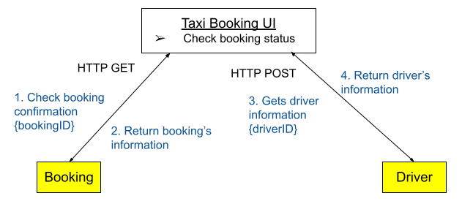
Microservice Interaction Diagram – Passenger checks the status of a booking request
Notes:
Passenger uses the Taxi Booking UI to check booking status by clicking on a Check Booking button
UI invokes Booking service, Get booking operation to obtain specific booking from the Booking db, booking table.
Return the booking with specified bookingID
Upon receiving the booking information, UI invokes the Driver service, Get driver operation to obtain the driver’s details from the Driver db, driver table.
Return the driver information with the specified driverID
UI displays all the confirmed booking with the driver information

Slide 9
Sample Technical Overview Diagram 1/2
Application/UI Name
Menu Items
Taxi Booking UI
Send a booking request
Check booking status
Microservices
Driver
Booking
Pricing
Service Name
Operations
Add new driver
[POST] /driver Get a driver details
[GET] /driver/{driverID}
Get a booking [GET] /booking/{bookingID} Get open bookings [GET] /booking/open
Update a booking
[PUT] /booking/{bookingID}
Add new booking [POST] /booking
[GET] price
Database Name
Table Name & Schema
Driver
Booking
If other than db, just put the fields and indicate type of storage, or “No storage”.
e.g.
Storage: File
name, age, etc
Driver
ID (INT) (auto increment)
Name (VARCHAR)
VehicleNo (VARCHAR)
Phone (VARCHAR)
Location (VARCHAR)
Booking
ID (INT) (auto increment)
PassengerID (INT)
DriverID (INT)
DateTime (TIMESTAMP)
PickUpLocation (VARCHAR)
Destination (VARCHAR)
Status (VARCHAR)
Price (DOUBLE)
Notes:
This is an overall Technical Overview Diagram showing the needed (micro)services in the scenario and possible implementation details.
It is good to fill this in with as many details as possible to plan your implementation, and observe the dependency between the UI to the (micro)services.

Slide 10

Sample Technical Overview Diagram 2/2
Application/UI Name
Menu Items
Taxi Driver UI
Get available bookings
Accept a booking
Complex Service
Operations
Accept booking
[POST] /acceptbooking/{bookingID}
Accept Booking
Service Name
Operations
Microservices
Passenger
Booking
SMS
You should adjust the layout to make everything visible and more readable.
E.g. move operations below the microservice.
Get a passenger details
[GET] /passenger/{passengerID}
Details in previous slide
Send SMS according to a request received via
[BKEY] *.notify
Database Name
Table Name & Schema
Passenger
Passenger
ID (INT) (auto increment)
Name (VARCHAR)
Address (VARCHAR)
Phone (VARCHAR)
Notes:
This is an overall showing the needed (micro)services in the scenario and possible implementation details.
It is good to fill this in with as many details as possible to plan your implementation, and observe the dependency between the UI to the (micro)services.
[BKEY] → Binding Key

